Slide 1
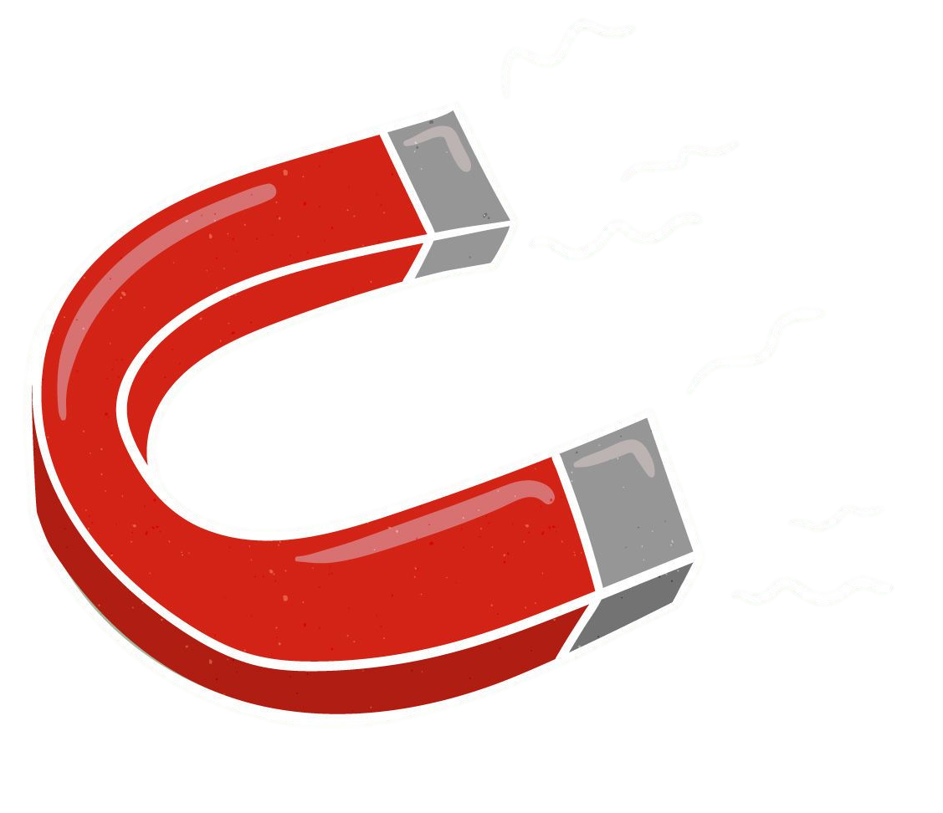
Fidget spinner pushed by an electromagnetic coil
Capstone Project
Submitted By,
Submitted To,
1. Khondokar Saim - 221902353
Dr. A.A. Mohammad Monzur-Ul- Akhir
2. Hasnat Zamil Sayad - 221902001
Assistant Professor
Email : monzur@eee.green.edu.bd
3. Ashiful Haque Shihab - 221902329

Slide 2
Table of contents
01
Description of the project.
02
How we got interested in this project.
03
Interpretation of project diagram.
04
project's final outcome
Describe short details about this project.
How we were able to select this topic.
Tools we used in this project and their descriptions.
Explain the project by summarizing the final results
This presentation is created by Khondokar Saim

Slide 3
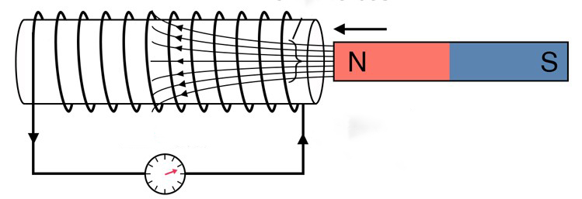
Description of the project
In this presentation, we learn how to how fidget spinner continuously spin pushed by an electromagnetic coil.
This project is generally based on the concept of "Faraday's Law of induction"
and this law is known as the basic law of Electromagnetism.
In this project, we will see how a magnetic field will interact with an electric circuit to produce an electromotive force EMF.

Slide 4

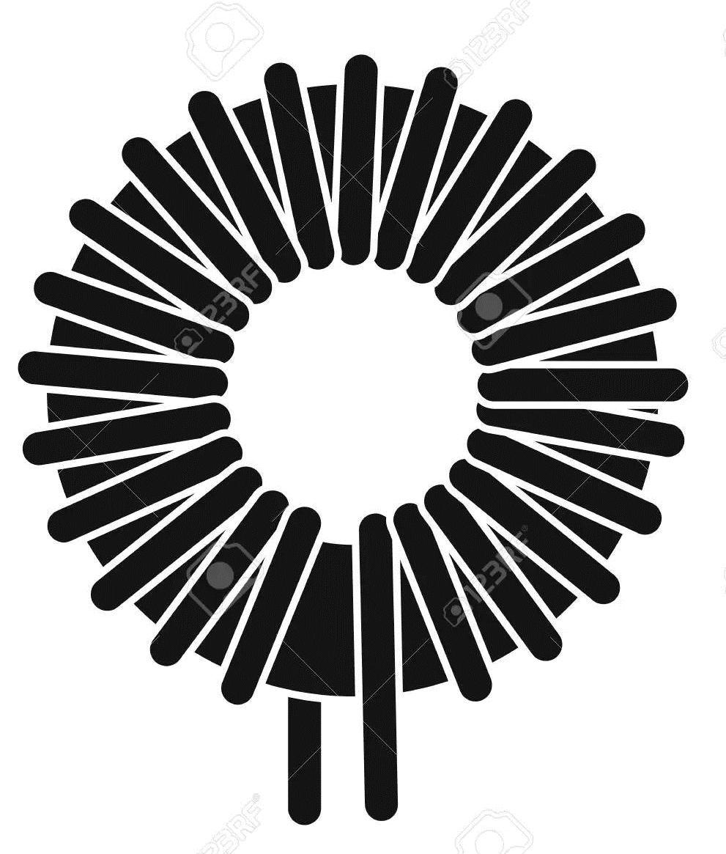
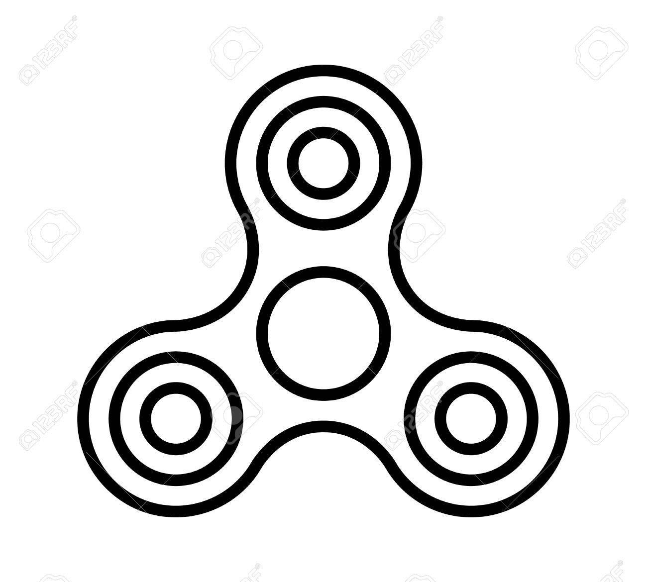
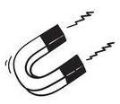

How we got interested in this project
First, we read this topic, which corresponds to our physics course electricity and magnetism. Then we think of making a capstone project with the fidget spinner and we share it with our group.
We put much thought into how to attach a magnet around a 3-point of a fidget spinner and then put it in contact with the coil to make the magnet and coil attract each other. As a result, the fidget spinner will be able to speed faster and continuously.
And based on this idea we are able to choose this project and wish to make it a reality.

Slide 5
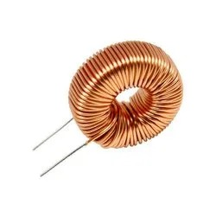
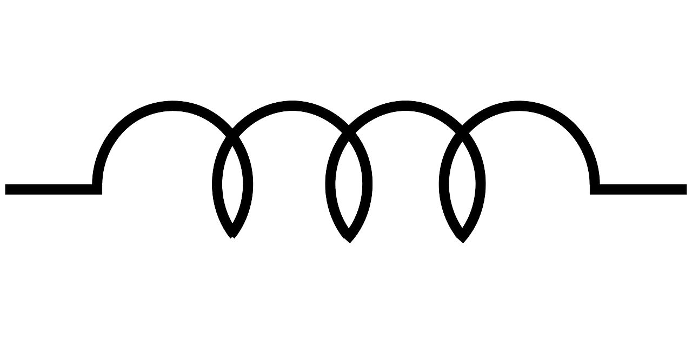
Interpretation of project Diagram
Fidget spinner
A fidget spinner is a toy that consists of a ball bearing in the center and it is designed to spin along its Axis with pressure
Electromagnatic Coil
Electromagnetic coils are used in electrical engineering in applications where electric currents interact with the magnetic field

Slide 6
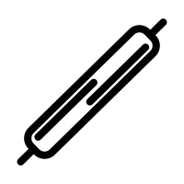

Reed Switch
The reed switch which is an electro-mechanical switch it is to control the flow of electricity in a circuit are made from two or more ferrous reeds encased within a small glass tube-like envelope, which become magnetized and move together or separate when a magnetic field is moved towards the switch.
Neodymium Magnet
A neodymium magnet is the most widely used type of rare Earth magnet. This type of magnet is made from an alloy of neodymium, iron, and boron

Slide 7
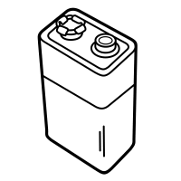
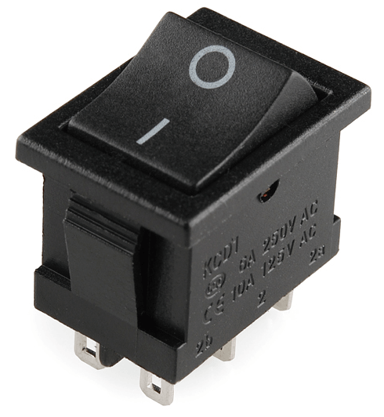
Battary
Alkaline battery
Design for to provide reliability and lasting performance for high and low drain products.
Switch
Size:21*15MM
Dielectric intensity:≥ 1800 VAC/3S
.

Slide 8
project's final outcome
Neodymium Magnets
Electromagnets are made of coils of wire with electricity passing through them moving charges to create magnetic fields. So when the coils of wire in an electromagnet have an electric current passing through them as a result coils behave like a magnet.
Fidget spinner
A wire coil is an electrical conductor with one or more terms designed to produce a magnetic field. this is commonly used to increase the strength of a magnetic field
Reed Switch
Another hand a reed switch is used to control the flow of electricity in a circuit. The current will flow through the reed switch and the coil when the switch is on.
Coil
Switch
Battery

Slide 9
project's final outcome
Neodymium Magnets
When the switch is on, the current flow will produce an electromagnetic field while the read switch repels the magnet on the fidget spinner. As a result, the fidget spinner gonna spin continuously.
Fidget spinner
So this project gives us an idea that how to continuously spin a magnet with the help of an electric magnetic coil without any external force applied to it
Reed Switch
Coil
Switch
Battery

Slide 10
Thank you

